Slide 1
EXPLORE.COM
Guide for you…

Slide 2
ABSTRACT
It happens many a times that we are new to a city and we have no knowledge of the frame of that place. Gathering the information about your new environment is quite an arduous task .
In today's world anything could be known within seconds through internet . But we still have trouble ,gathering the whole information we search for . Many a times we do not get the exact information about
that place at a single go or at once even after searching in the internet and also asking different people about it, we are not sure that we can get the exact and complete information from them.

Slide 3
INTRODUCTION
This website is for the people who are new to a city.
This is the live website where costumer can get access to the sight links .
They can get the details about certain fields they want.
This project is the web based project(not entirely) project where web design languages are used for designing web pages.

Slide 4
LITERATURE SURVEY
Everything is available at one place.
Easily accessible through internet.
Takes very less time.
All in one guide.
It's panoptic .

Slide 5
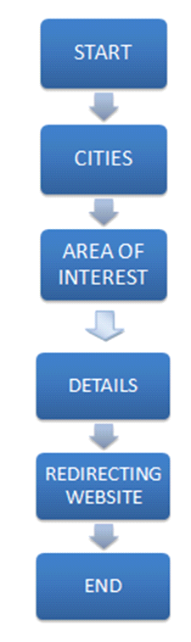
DESIGN

Slide 6
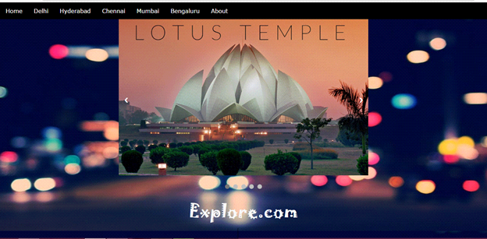
IMPLEMENTATION

Slide 7
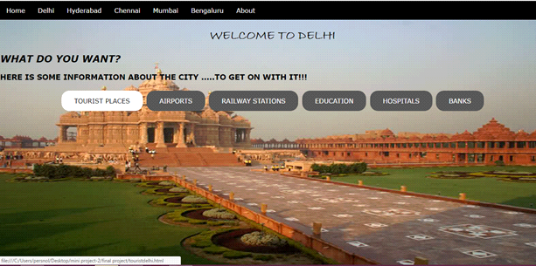

Slide 8
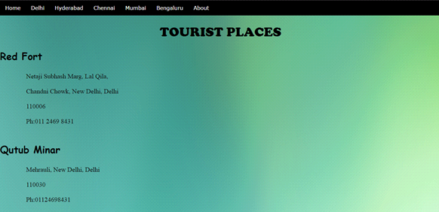

Slide 9
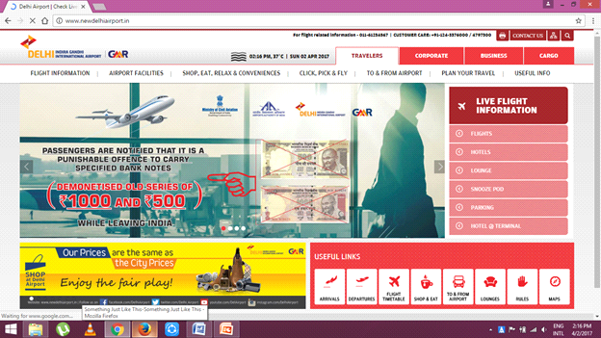

Slide 10
CONCLUSION
The website provides the required information at one place without searching in many websites.
Reduces repeated search to gather information.

Slide 11
THE
END

